Slide 1

The Potato Vendor dApp
A Decentralized Token Vending and Locker System

Slide 2
Overview
dApp for ordering potatoes online and delivery through a locker
Privacy Centric: use wallet instead of showing id or person interaction
Customer Centric: no gas fees to buy potatoes or to open a locker
Frontend: developed on scaffold-eth
Backend: based on a daemon listening to all the events coming from the frontend

Slide 3
Features
Gas Optimization
The use of ERC20Permit allows buyers to approve token spending off-chain, reducing the number of on-chain transactions
Security
Role-based access control ensures that only authorized accounts can mint tokens or manage purchases
Cryptographic signature verification ensures that only the rightful owner can open lockers
Event-Driven Integration
Events enable seamless integration with backend systems or external applications for notifications, tracking, and analytics
Queue Management
Serialization of concurrent calls for buying potatoes in order to correctly process transactions and increment nonce values

Slide 4
PotatoToken contract
an ERC20 potato stablecoin
Implements IERC20Permit to provide gasless allowance
Price tied to the price of a potato by the EATER DAO
If potatoes get too cheap, they receive a lot of potatoes from the supply
Otherwise, the reverse

Slide 5
PotatoVendor contract
The permit function calls the IERC20Permit.permit with signature and content, raising an event for the potato-daemon
GetApprovedAmount function transfers the allowed potato tokens to itself
ReserveLocker function assigns an available locker with the use of randomness and integer overflow
OpenLocker function opens the locker if user provides signed message of the locker number

Slide 6
How It Works
BE/FE for buying potatoes and opening locker on public internet
Daemon (TEE) to listen to events
BuyPotato: register buyer email and reserves locker
LockerAssigned: send order confirmation to buyer with locker number
LockerOpened: send pickup confirmation to buyer
The user:
Gets notified by email about locker reserved when buying potatoes
Gets notified by email about picking up potatoes when the locker is opened

Slide 7
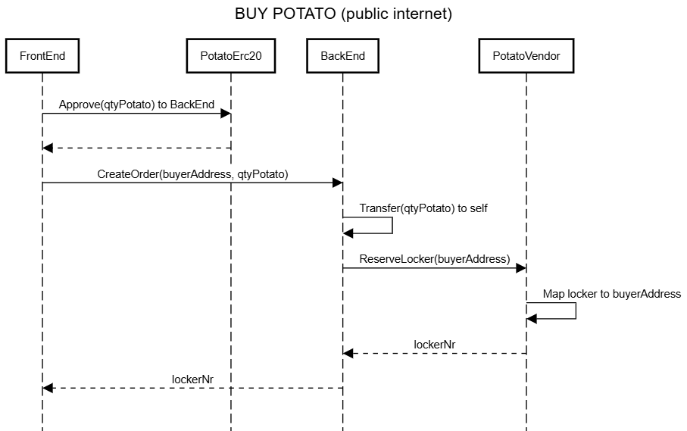
How It Works

Slide 8
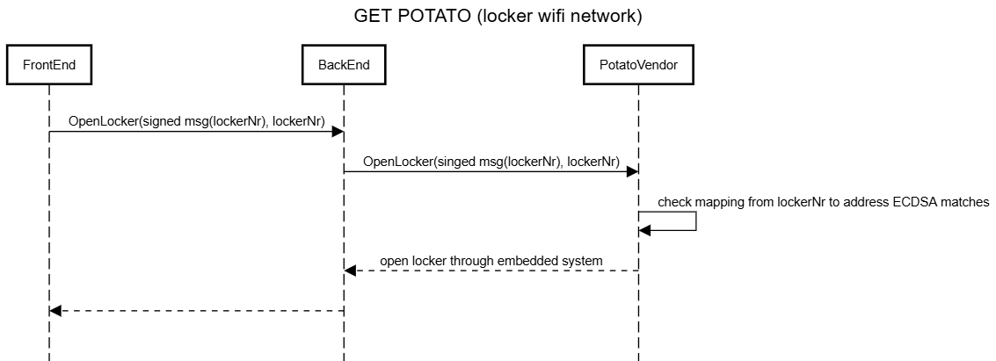
How It Works

Slide 9
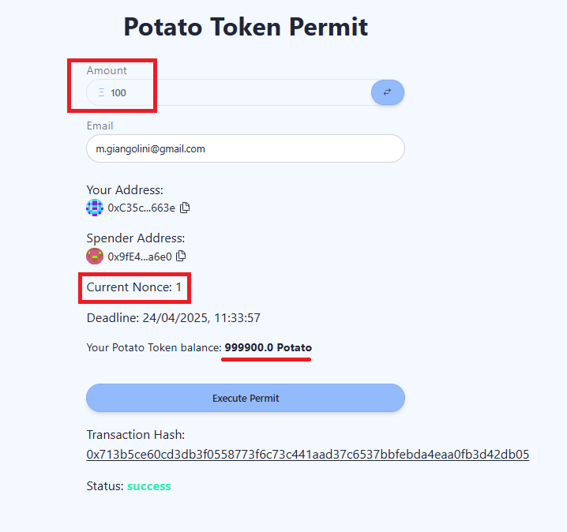
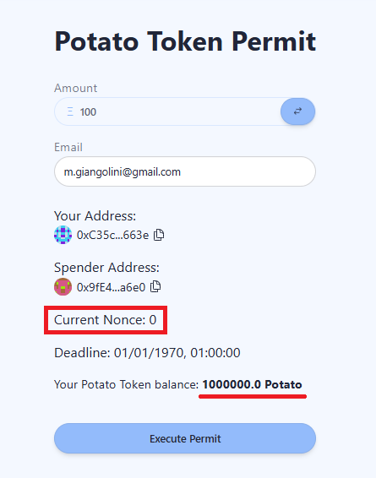
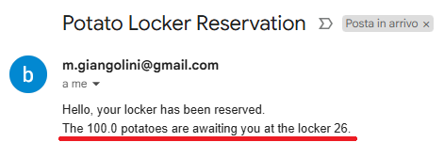
How It Works

Slide 10
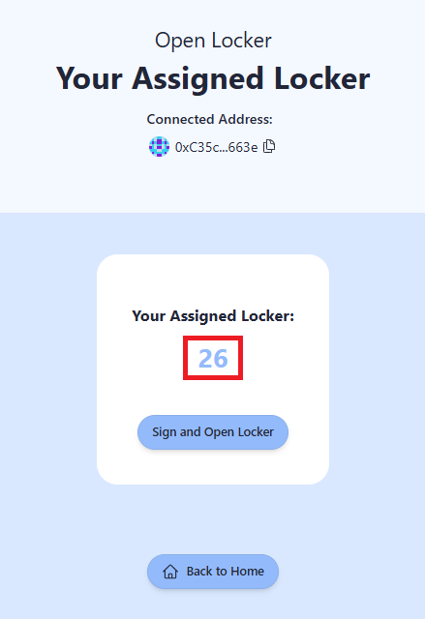
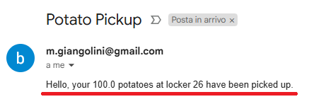
How It Works

Slide 11
Use Cases
Gasless purchases
Locker-Based Delivery
Handling of goods for which privacy is paramount

Slide 12
Improvements & Conclusions
Implementing oracles to tie the price of potatoes with USDC stablecoin
EVM events can be used as Kafka / ServiceBus to a TEE
Use NestJS BE instead of scaffold-eth (time issue)

